Slide 1
Income Inequality: Determinants and Effects
Measurement Problems
Measures
Relations to Poverty
Decomposition
Relation to Development
Determinants and Effects

Slide 2
Measurement Problems
Because of costs involved most estimates are from hh surveys
Frequently interviewees are reluctant to reveal information about income
Income hard to compute for farmers, especially subsistence farmers
Timing of survey may matter, with timing differences, survey results may not be comparable
Measurement Error

Slide 3
Measures
Lorenz Curve
Gini Coefficient
Theil Indexes
Normal and Lognormal Distributions
Log Variance
Kuznets Ratios

Slide 4
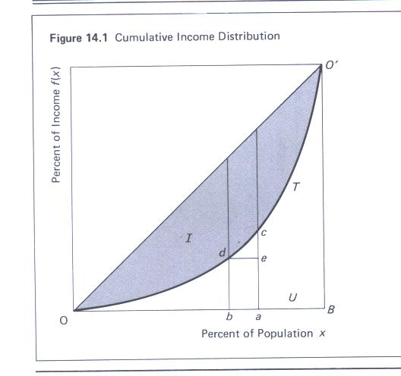
The Lorenz Curve and Gini (I/I+U) or G= 1-Σ(ab)(bd+ac)

Slide 5
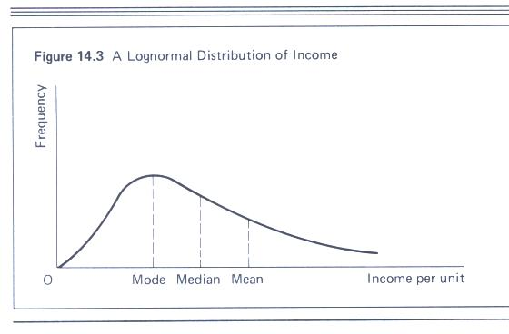
Lognormal Distribution
Measure standard deviation of the logs of income

Slide 6
Theil’s Information Theory Index
Σ y_{i} log (y_{i}/x_{i}) where
  y_{i} = income share of group i
  X_{i} = population share of group i

Slide 7
Atkinson’s Welfare Measure
W = ∫₀^{y}U(y) f(y) dy
I = 1 – (y_{EDE}/μ)
  Where y_{EDE} = equally distributed equivalent income
  μ = mean income
  This index goes from 0 to one
  This index depends on the nature of the utility function

Slide 8
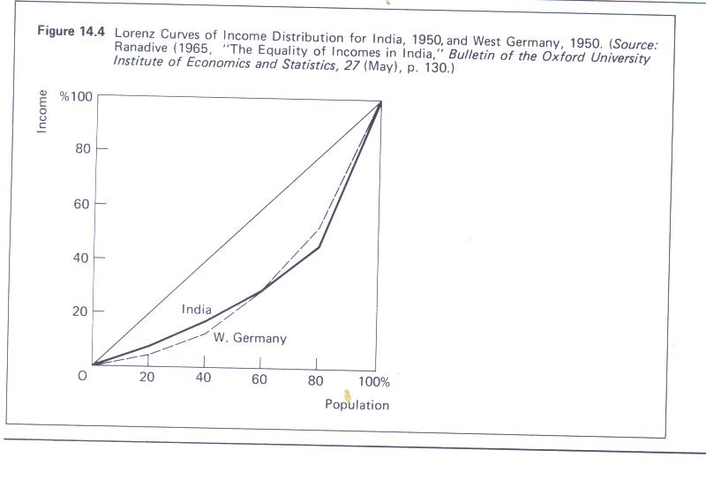
Lorenz Curves May Cross: Inequality Comparisons Ambiguous

Slide 9
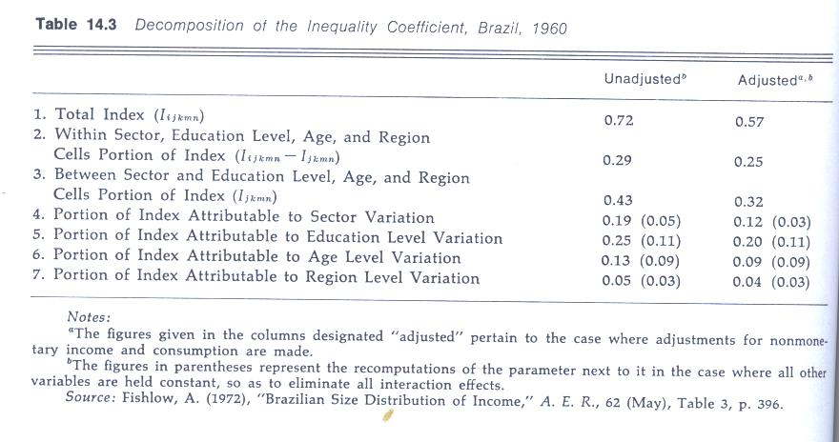
Decomposition Analysis via Theil Applied to Brazilian Inequality

Slide 10
Choosing between the Measures
Welfare Criteria
Possibility of Decomposition Analysis
Sensitivity to Outliers
Emphasis on different parts of the distribution
  Standard dev. Of logs: lower part of distr.
  Gini: middle
  Theil: Upper part of distribution

Slide 11
Inequality and Development
The Kuznets Hypothesis Inverted U
Kuznets Explanations: sectoral change, education, political institutions
Evidence in support of cross-section relation but not necessarily over time
Various other determinants: size distribution of firms, legal and other institutions, technology

Slide 12
Effects of Inequality
Credit constraints and inefficient resource allocation, lower investment
Via education: Sectoral change, migration
Public goods undersupply
Ability of political economy to react to shocks
Conflicts, Lack of respect for property rights
Democracy
Trade Patterns
Growth

Slide 13
Evidence on Inequality on Growth
Deininger and Squire
  Showed that the effect of Land inequality was more strongly negative than that of income inequality
  Many studies on this subject. It remains very controversial
  Many methodological problems: measurement error, endogeneity, omitted variable bias

